Slide 1

Making Sense of the 2020 LA District Attorney Gascon’s Criminal Justice Reforms
Charles Carbone, Esq. Prisoner Rights Attorney
Steve Castillo, Paralegal
December 28, 2020

Slide 2
Overview
“Nuts and Bolts” of How to Apply, likely timetables, and procedural considerations
“Big Picture” Considerations
Disclaimers and Background Directives
20-14 Directive on Resentencing:
- Open cases
- Pending Habeas and Petitions for Recall
- 1170.94 petitions (SB 1437) reforms to felony murder
- Resentencing Unit via Petitions for Recall for Past cases
- Parole Hearings
- Juvenile Court – 707 proceedings
- LWOP taken back to juvenile court
20-08 Directive on Sentencing Enhancements
What applies to me?
Do I need a lawyer?
Odds and Ends/Conclusions

Slide 3
Disclaimer
We are not the LA DA’s office.
Charles has 25 years plus of prisoner rights law and advocacy.
Steve has 20 years plus as a paralegal and prisoner advocate.
We have studied the law, but more importantly, we have lived the law.
Second SB260 hearing ever.
Second successful Petition for Recall.
First file and successful SB 1437 cases. (fyi on People v. Gentile)
Opposed the DA’s of LA County in parole hearings and habeas petitions literally hundreds of times.
Hundreds of commutation petitions, parole hearings (1000+), petitions for recalls, compassionate release requests, medical parole, etc.
Highly informed/understood positions.
By definition, this nascent process will evolve/devolve based on:
- Volume of cases for past review
- Staffing/rescourcing of the Conviction Review Unit
- Receptivity of the LA County Superior Court judiciary
- Both judicial and public relations success or failure
-Re-election in 2024 (Democratic Party of CA/LA, SEIU v. Police Unions)

Slide 4

Background on November 2020 Election:
Election – Jackie Lacey v. George Gascón
Primary election: 48% to 28%, Lacy.
General election: 53% to 46%, Gascón
Money in politics: Lacey raised $829,000 to Gascón’s roughly $1 million.
Endorsements heavily favored (even switching endorsements) for Gascón, including Democratic Party of CA/LA and SEIU.

Slide 5
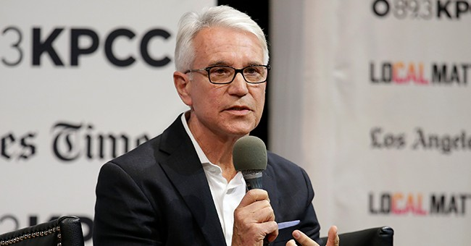
WHO IS GEORGE GASCÓN AND WHAT IS HIS TRACK RECORD?
The first Latino to hold the DA’s office in San Francisco, and the nation’s first police chief to become District Attorney in SF in 2011.
In 2009, then-Mayor Gavin Newsom appointed Gascón to be San Francisco’s Chief of Police. In 2011, when then-District Attorney Kamala Harris vacated her seat after being elected California Attorney General, Newsom picked Gascón to be San Francisco District Attorney.
Notables/deliverables while the DA in San Francisco:
Violent crime dropped dramatically during his tenure (especially with Police Chief), with uptick in “quality of life” and property crimes.
Aggressive investigation on police misconduct cases.
Supported Propositions 47 (which eased punishment for some nonviolent offenders).
Supported Assembly Bill 109, commonly referred to as realignment which allowed some people to serve their sentences locally.
Supported AB 1076 which automatically wiped out some already eligible records of offenders’ convictions and arrests.
Expunged marijuana convictions dating to 1975 after voters passed Proposition 64, legalizing cannabis for personal use.
Sought to end cash bail.
Reduced SF jail population by 30%.
Sought to implement a blind-charging tool that removed suspects’ racial information from police reports.

Slide 6
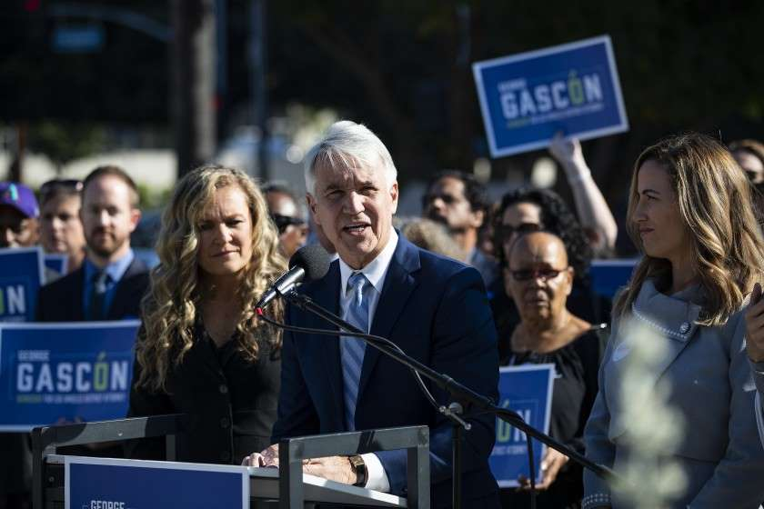
GEORGE GASCÓN – cont.
NOW heads largest District Attorney Office in the United States:
STATED GOALS:
  End Death Penalty Prosecutions.
  Alternative Sentencing Measures.
  Sentencing parity and equity.
  Reducing Mass Incarceration.
  Pursing backlogged rape kits with serious prosecution of sex offenses.
  Stricter use of force standards for police and investigation of police misconduct.
  Weapons analysis to solve crimes.
  Eliminate money bail.
  Diversion for drug crimes and mental illness related offenses.
  Environmental justice

Slide 7
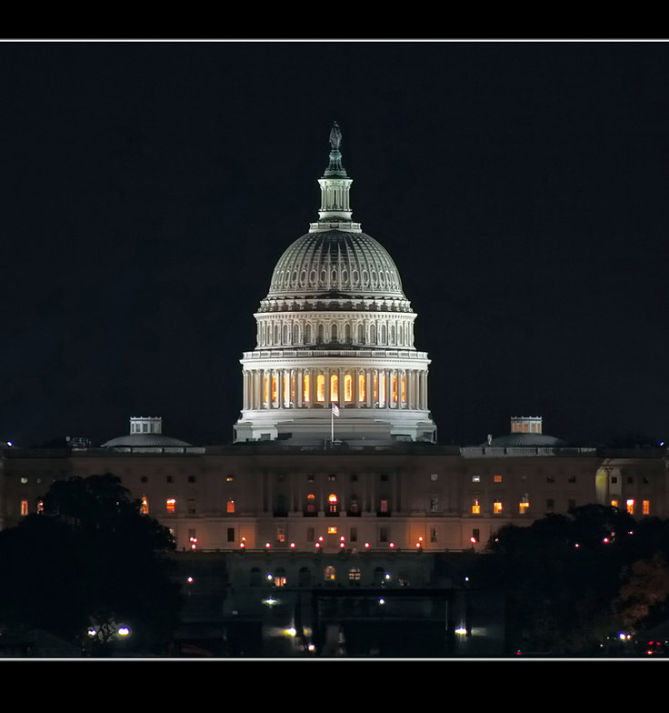
Background
Nation-wide trend:
George Gascón, Los Angeles.
Chesa Boudin, San Francisco.
Jeff Rosen, Santa Clara.
www.prosecutorsalliance.org (SF, San Joaquin, LA, Contra Costa)
Kimberly Gardner (first AA), St. Louis, MO.
Kim Foxx (second largest DA’s office in US), Chicago, IL.
Larry Krasner, Philadelphia, PA.
Tucson, Atlanta, Portland, Austin.

Slide 8
California’s trend for CJ Reform
Youth offender laws (SB 260, SB 261, AB1809)
CA DA’s no longer pursuing Death Penalty (LA, SF, Santa Clara)
Prop 57 parole review for non-violent offenders.
Death Penalty Moratorium.
Proposition 47.
Closing DVI.
CYA closed, Division of Juvenile Justice opened.
End of long-term solitary confinement in CDCR.
Commutations increased.
Petitions for Recall of Sentence.
14 percent grant rate for BPH with fewer Governor reversals.
Amended PC 5058.7. Attorney Phone Calls.

Slide 9
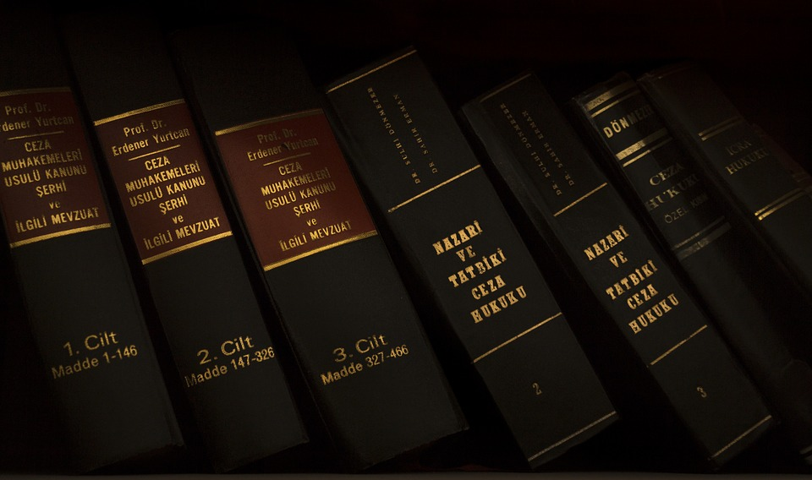



BIG PICTURE CONSIDERATIONS
Volume of past cases
- “20,000-30,000 cases with out-of-policy cases” @ page 6 of 20-14 Directive.
- “He [Mike Romano of Stanford Law Clinic] estimates that he would have the capacity to do approximately somewhere around 1,000 cases per year. So, 20,000 that would be 20 years to do that. Obviously, that’s an unacceptable state of affairs. So, what we’re trying to do is “we’re trying to identify and working to get funding and additional people to assist with this.”
Resources
- “We’re doing this at a time when there are substantial cutbacks.”
- “So, the first thing that we’re doing now is we’re forming a working group, we’re analyzing the scope of the work, then we’re going to try to identify funding sources and resources both internally (within government).”
Timing
“We’re in the process of creating a team to do this work. It’s gonna take probably – I suspect around 60 days.”
Start filing in February 2021, perhaps.

Slide 10

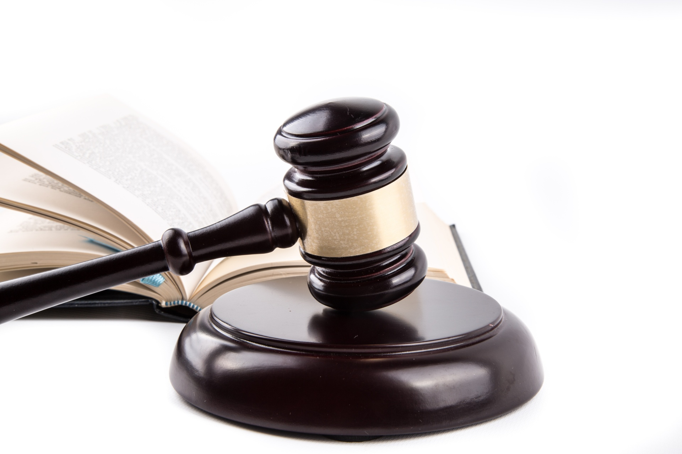

BIG PICTURE CONSIDERATIONS – cont.
Minimum of 4 years to effectuate
These are policy changes which even while in process can be undone. Elections matter.
Herculean task while take time, priority.
Make it “easy to grade,” “easy to review” may increase visibility/viability of review & sentence modification.
Judges decide these – not the DA
494 judges (serve for 6 years, Superior court judges serve six-year terms and are elected by county voters on a nonpartisan ballot at a general election. Vacancies are filled through appointment by the Governor.
Professionally many Judges (Honorable William Ryan, Mildred Escobedo, etc.) not likely to share Gascon’s policy changes.
Court of Appeals – Second Appellate District. Will decide any close calls.

Slide 11
“NUTS & BOLTS” – PROCEDURAL CONSIDERATIONS
1. Proactive Review for PAST cases:
“So, this is the work that’s going to occur whether you approach us or not. If you qualify, we’re gonna look at it. We’re just trying to figure out how to get the work done and get it through.”
No present understanding as to prioritization of sentencing reforms for past cases.
Use of “Conviction Review Request Form” (See end of presentation for complete copy).
Calls for “new evidence” not known at time of trial.
“Reasons the conviction should be reviewed.”
Opportunity to present exhibits or documents.
Both scant space for presentation of such evidence.
2. No Implementation Date Required for particular reforms:
Parole Hearings.
Pending criminal prosecutions – 30 days continuances to assess whether prosecution is per new policies.
Pending Habeas Corpus, Petition for Recalls, 1170.95 Petitions (SB1437).
3. Preference for “Heavy Lifting” Lawyering Which Needs/Can be Done Prior to Submission:
Not only for DA’s acceptance, priority - but also for ultimately the Judge’s Order.
Metaphor: the difference between submitting half-baked pie OR cooked, packaged, with a bow. Which one will be served first?
Which will prove “tastier” (well-reasoned) for the judge.
Identifying procedural history, statement of facts, review/analysis of trial record, appellate record, compliance with per-policy criteria, distillation/presentation of in-custody record, presentation of parole/re-entry plans.
Advance and defend claims once a legal instrument has been filed.
“Shared” legal resources if represented by counsel.

Slide 12
20-14 DIRECTIVE ON PENDING PETITIONS FOR RECALL OF SENTENCE AND HABEAS/RESENTENCING (MILLER, FRANKLIN, ETC.) CASES – cont.
For EXISTING Petitions for Recall, Habeas Petitions, Remanded cases on appeal, or 1170.95 (felony murder):
If sentence is greater than per newly enacted policies, DA “shall” stop opposing and start support resentencing per present policy.
If sentence would NOT meet new policy, still NOT out of luck because, DA seeks 30-day continuance, to evaluate whether to support or oppose based on “compelling and imminent public safety” concerns:
(a) If SUPPORT, no need to justify to Head Deputy.
(b) If OPPOSE, need to justify to Head Deputy.
(Hence, only have to go to your boss if DDA opposes)

Slide 13
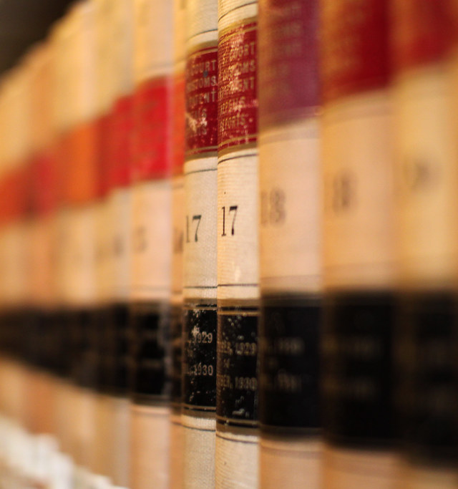
SB 1437 Petitions (aka 1170.95): 2018 Changes to Murder Laws In California
Only convicted of murder if:
1. was the actual killer;
2. with intent to kill, aided or abetted the actual killer in the commission of the murder;
3. was a major participant in the underlying felony and acted with reckless indifference to human life (Banks, Clark analysis).
Exclusions apply when victim was on duty police officer.
Largely dismantles “felony murder rule” in CA.
Constitutionality now broadly affirmed.
Courts still deciding:
  Attempts.
  Standard of proof (BRD or Sufficient Evidence)
  Special Circumstances finding.
  Threshold for OSC on evidentiary hearing.

Slide 14

LA DA’s TWENTY POINTS ON SB1437
1. Support Constitutionality.
2. Petitioner should get a lawyer and no summary denials.
3. Applies to manslaughter cases too.
4. Prior findings on lack of major participation and reckless indifference by court, jury or magistrate control. There are no second bites at that apple for DA.
5. No fact finding by judge at stage of letting it go to hearing even though judges can disagree.
6. Special circumstance does not preclude going to eligibility and going to hearing (e.g., jury guilty finding on personal use of a firearm).
7. If actual killer theory was abandoned (in plea or prior to trial), DA can’t invoke actual killer theory in 1170.95 petition.
8. Applies to attempted murder (presently on appeal before CA Supreme Ct.)
9. People v. Chiu- if previously won, can’t change legal theories.
10. Can’t now argue aider and abettor theory of criminal liability if not previously presented to the jury.
11. Can’t argue felony murder if not previously presented to the jury.
(Think: DA must take consistent version of the crime in assignment of respective responsibility/culpability of participants.)
(Think: Can’t change the story every time you tell it to the Court.)

Slide 15
LA DA’s TWENTY POINTS ON SB1437 – cont.
12. If jury got clear instruction on felony murder, case “must proceed” to evidentiary hearing, where DA bears burden of proof.
13. At hearing, DA retains right to introduce “new or additional evidence” of actual killer or major participant who acted with reckless indifference if consistent with previously advanced theory of the case.
14. Standard of proof is beyond reasonable doubt NOT substantial evidence.
15. Statements made at parole hearings are excludable.
16. No “unavailable witnesses” and no inadmissible hearsay from experts (gang expert was told by police officer about gang status of defendant).
17. Right to examine exculpatory evidence (“Brady” evidence).
18. Can present mitigating evidence related to juvenile status (“Franklin” evidence).
19. Reckless indifference analysis includes: (a) under the age of 25 (diminished capacity), (b) mental illness, (c) voluntary intoxication.
20. Dismiss any enhancements pursuant to policy (already in practice).

Slide 16
20-14 DIRECTIVE ON PENDING PETITIONS FOR RECALL OF SENTENCE AND HABEAS/RESENTENCING (MILLER, FRANKLIN, ETC.) CASES
Understanding the terms:
PETITION FOR RECALL (AB1812):
(Cal. Code Regs. Tit. 15, § 3076.2 - Recommendation Based on a Law Enforcement, Prosecutorial, or Judicial Referral AND/OR CA PC §1170(d)(1).
Sponsored by BPH, CDCR Secretary, CDCR Employee to the CDCR Secretary, and or the District Attorney.
Once sponsored, referral to DA made.
Can be brought “at any time” per statute.
AB 1812 granted additional funds to the CDCR to investigate potential cases to refer for recall of sentence.
Applies to both plea agreements & trials.
Courts have authority to recall a sentence and resentence a person if “it is in the interests of justice” and where “a person demonstrated exceptionally meritorious conduct in prison.”
DEFINING “INTERESTS OF JUSTICE:”
An inmate shall be eligible for consideration pursuant to subsection (a)(2) if their sentence, as reflected in the Abstract of Judgment, contradicts applicable sentencing laws at the time of their sentencing hearing or subsequent decisional law suggesting the substantial likelihood of a sentencing error.
If the applicable sentencing laws at the time of their sentencing hearing are subsequently changed due to new statutory or case law authority with statewide application.
“So as to eliminate disparity of sentences and to promote uniformity of sentencing.”
“The court may consider postconviction factors, including, but not limited to, the inmate’s disciplinary record and record of rehabilitation while incarcerated, evidence that reflects whether age, time served, and diminished physical condition, if any, have reduced the inmate’s risk for future violence, and evidence that reflects that circumstances have changed since the inmate’s original sentencing so that the inmate’s continued incarceration is no longer in the interest of justice. Credit shall be given for time served.”

Slide 17
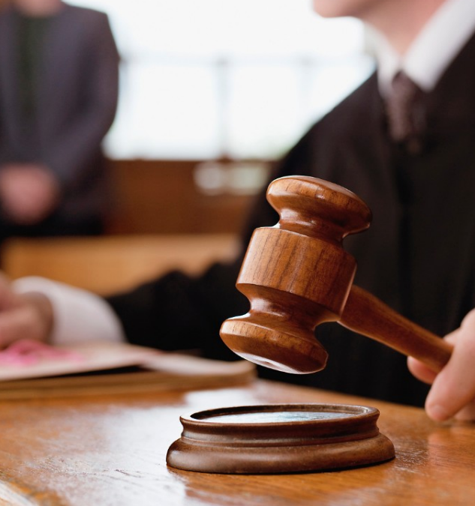
PC 11709(d)(1) Recall of Sentence
PC 11709(d)(1): RECALL OF SENTENCE
IF past sentence is INCONSISTENT with new policy on:
Enhancements.
Special Circumstances.
DA will initiate PETITIONS FOR RECALL:
PRIORTY Given to SIX categories but “ultimate goal to remediate every sentence” per policy:
Served 15 years or more.
60 or older.
Co-morbidity for COVID (3 or higher Covid Score).
Recommended for recall by CDCR/BPH.
“Criminalized survivors” aka “battered woman”
17 or younger at time of crime, prosecuted as adult.

Slide 18
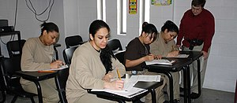
“What you did/doing in prison matters, a lot – rather than just record of conviction/crime.”
LA DA will be SPONSORING Petitions for Recall of Sentence and “shall assist” the sentencing court in presentation of mitigation evidence including:
a) CDCR disciplinary records.
b) Record of rehabilitation.
c) Age.
d) Time served.
e) Elderly, health problems – diminished physical condition.
f) “No longer interests of justice” – catch all phrase.
g) Family or community support on release.

Slide 19
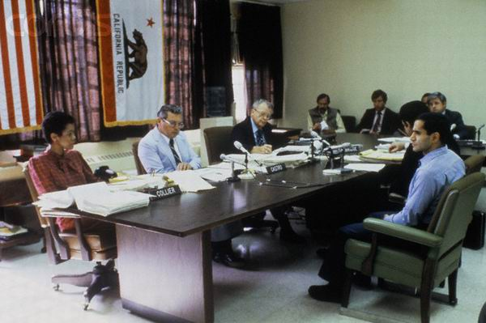
Lifer Parole Hearings Before BPH
Background (past vehement boiler – plate opposition):
  Delagarza, Farmer, Dahle.
  Broken promises on law enforcement cooperation.
NEW CHANGES:
  Default is “we will NOT attend parole hearings” AND we “will SUPPORT IN WRITING” as long as met YEPD/MEPD or EPD, unless “high risk” in Comprehensive Risk Assessment (which presently lasts 3 years), and for “high risk” folks – DA will take “neutral” position.
EFFECT:
  May disincentivize VNOK opposition/participation, but VNOK’s still entitled to appear and or oppose.
  BPH not likely to be markedly swayed but likely impact will be greater on Governor Review and or en banc.

Slide 20
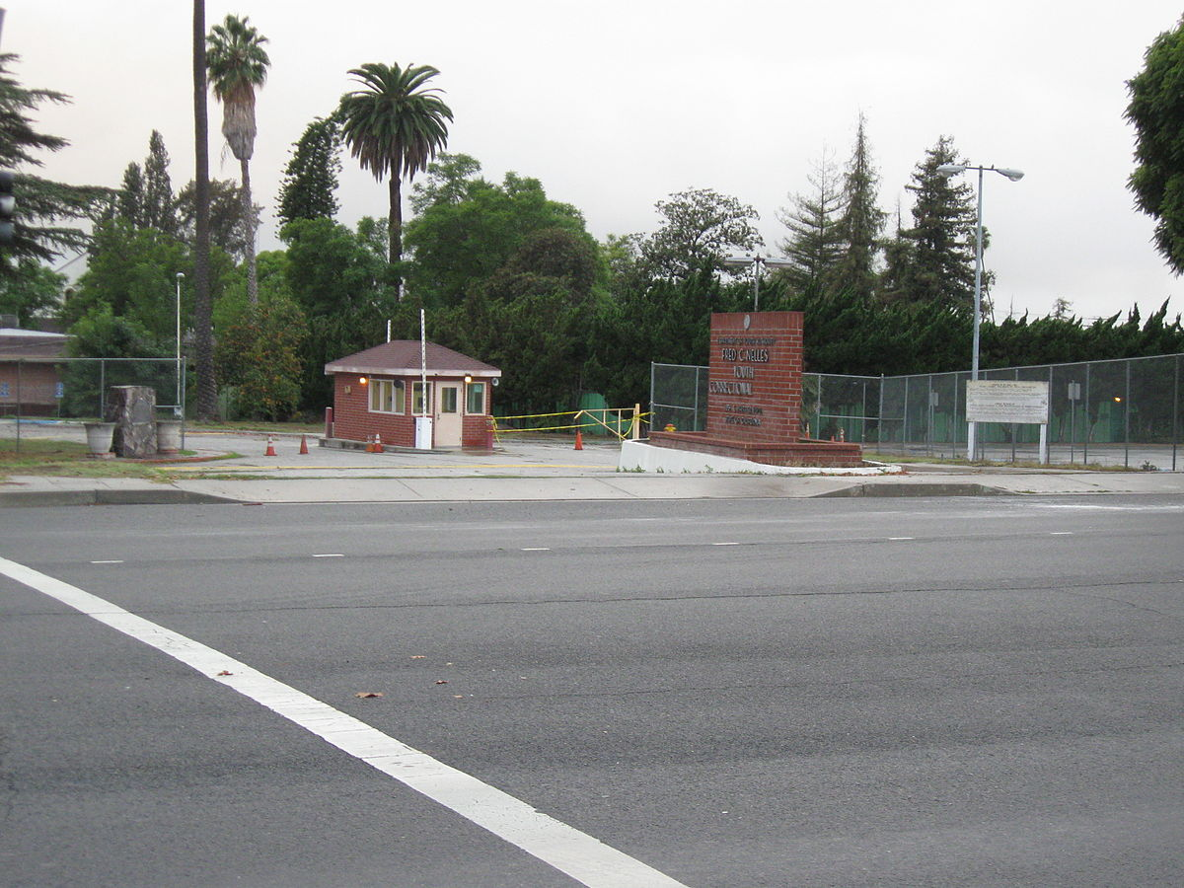
Youth and Children
707 Transfer with New Prop 57 Criteria (totality of the record v. total compliance):
  Less culpable on crimes.
  Capable of greater change in less time.
  Less in need to serve long sentences.
Under 17, stay in juvenile system, not transfer to adult court (default in Prop. 57).
Minor at time of crime, and has active Recall, Franklin, Miller hearing, DA will NOT oppose transfer to juvenile court (LWOP example).
“Shall join in any defense motion seeking to transfer the person to juvenile court.”
Juvenile court has broader range of sentencing options.

Slide 21
ENHANCEMENTS – DIRECTIVE 20-08, with Amendments (Dec. 18, 2020)
Clarity over “WHICH” enhancements are IN and which are OUT for EXISITING and PAST cases with underlying acknowledgment that longer time in prison causes greater recidivism than it prevents.
Which Enhancements ARE included:
Prior-strike enhancements PC 667(d-e), 1170.12(a) and 1170.12(c).
Gang Enhancements.
Special Circumstances (financial gain, premeditation) resulting in LWOP.
Personal use, discharge, possession of firearm.
Which Enhancements ARE NOT excludable (these will still be prosecuted):
Hate crimes.
Elder abuse.
Child abuse.
Sexual abuse.
Human sex trafficking.
Financial crimes implicating amounts and/or vulnerable populations.
Extremely barbaric/callous (i.e., torture, post-mortem).
(Deviations from policy can be sought and obtained between DDA and Head Deputy.)

Slide 22
WHAT APPLIES TO ME?
WHAT APPLIES TO ME?
Relevant Questions:
What is the underlying crime?
For murder cases, what was theory of murder prosecution (principal versus aider and abettor or felony murder).
How old was LO at the time of the crime?
What enhancements were applied?
What was the sentence (apportionment of the length of time per principal/base sentence versus enhancements)?
Past, or pending case?
Most in this Seminar are going to be via Recalls, and if so, does LO meet one of the 6 criteria?
If so, what to submit?
  Court of Appeals decision.
  Abstract of Judgment.
  Probation Officer’s Report.
  Transcript of sentencing.
  Jury instructions.
  Comprehensive Risk Assessment (if a lifer).
  Previous appellate/habeas appeals.
  CDCR records of rehabilitation
  Family/community support.
  Proof of transitional housing upon re-entry.
What instruments, if anything, have already been submitted/filed?
Can you borrow from those to submit to DA?
Exhibits for Intake form.
With or without a lawyer.

Slide 23
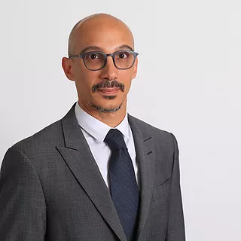
DO I NEED A LAWYER?
No, but it helps – a lot.
If charging for services, must be/should be licensed attorney or working with one.
If not charging, that’s different. Free advocacy is free advocacy.
What can a lawyer do?
Review eligibility.
Prepare the Intake Form plus Exhibits for “easy application.”
Prepare the Initial Filing.
Honest broker in presenting to the Court.
Preparation and submission of later legal filings (sentencing memos, etc.).
Provide “united front” when interfacing with the Court.
Better understanding and advancement of “all sentencing options.”
Advisement of rights.
Sheppard the case more quickly.
All legal research and writing for court filings.
Advance legal argument on any controversies between/among client, DA, and Court.
Handle all resentencing matters before the Court.
Field client and family’s questions throughout.
Strategize on where/timing to place resources (e.g., BPH or LA DA).

Slide 24
ODD’s and END’s // CONCLUSIONS
Take this window of opportunity now.
Worry that 4 years is not long enough to get it all done.
Judges decide, DA and defense counsel persuade.
Stipulations can speed process along.
More LA County parole dates for lifers will occur.
LWOP by special circumstances will likely be affected.
Get to the front of the line in the Court’s docket.
Get ready of COVID19 to complicate, especially because it’s LA County.
Ultimately how many resources are devoted to LA DA will matter greatly.
State-wide legislative relief is the ultimate goal.
All politics is local and personal – get and stay involved.

Slide 26
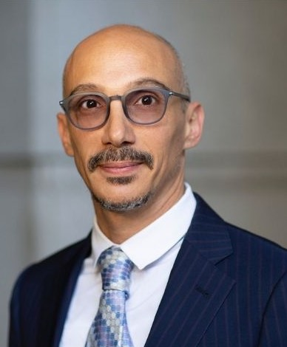
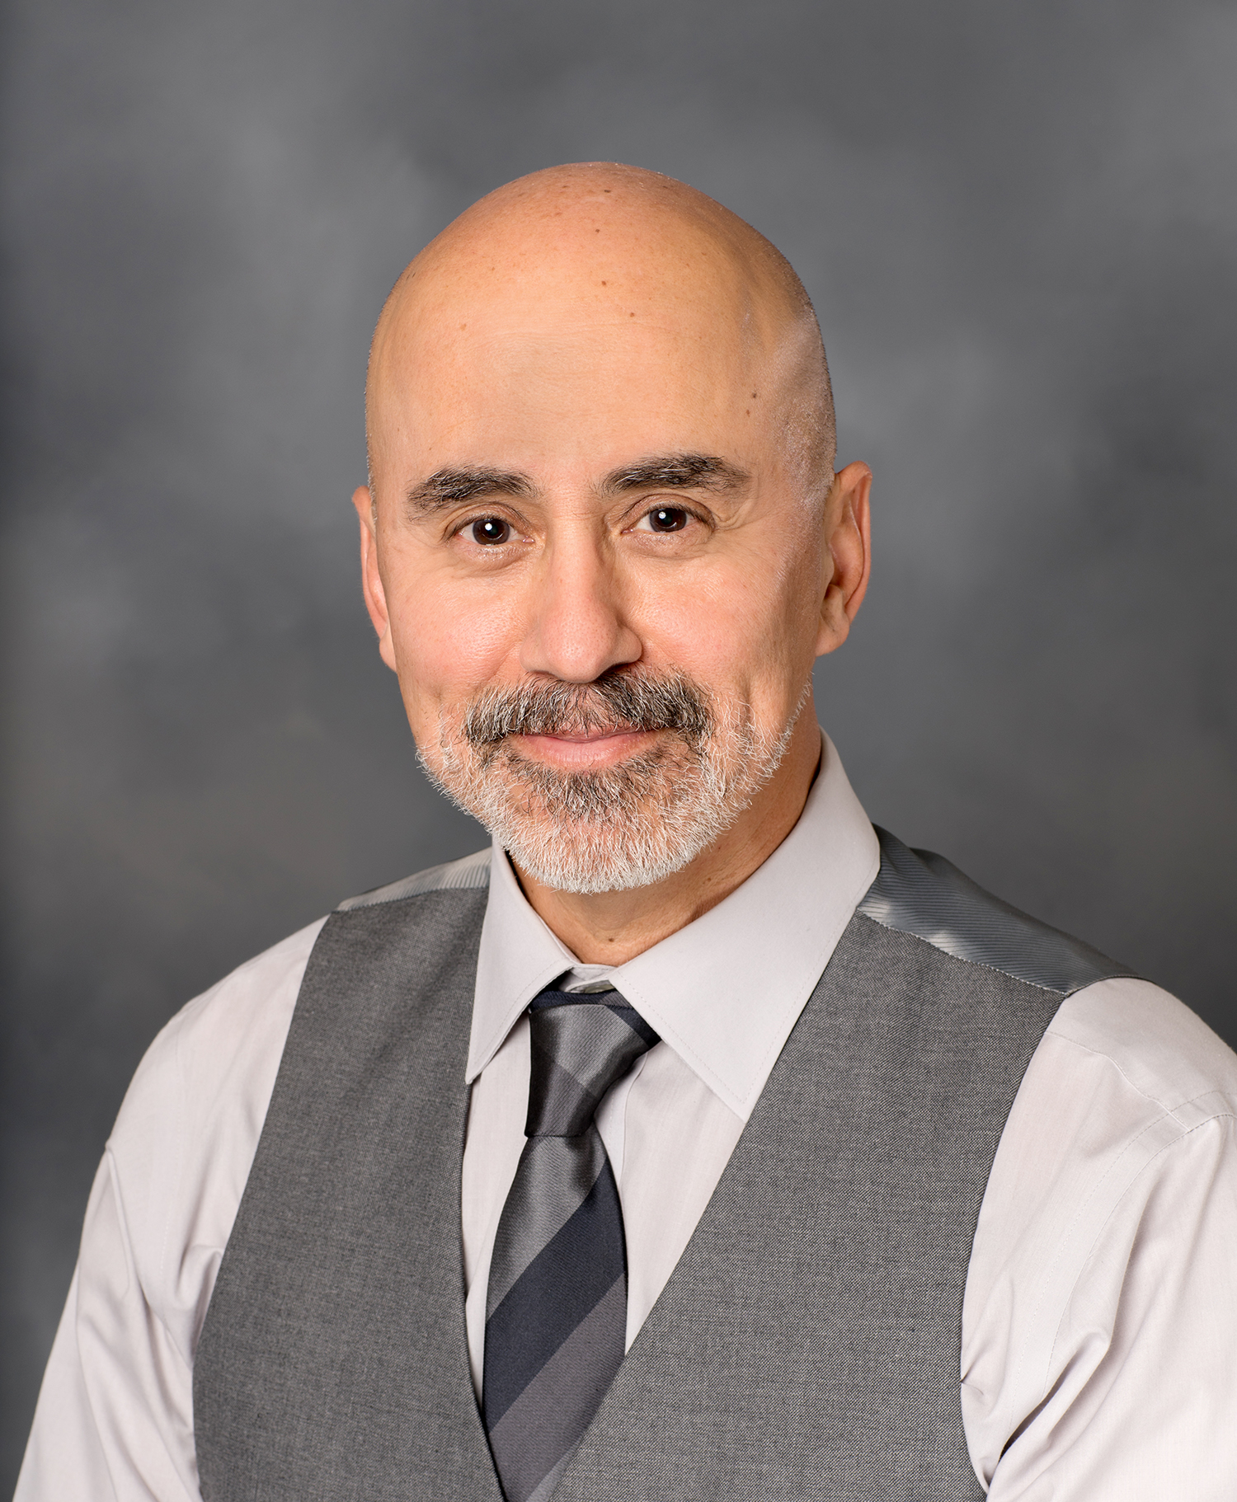

Charles Carbone, Attorney
Steve Castillo, Paralegal
P.O. Box 39755
Downey, CA 90239
www.stevecastilloconsulting.com
Copyright © 2020 Charles Carbone, Attorney at Law- All Rights Reserved.

