Slide 1
How to Answer Questions Before the Parole Board
Charles Carbone, Esq.
Steve Castillo, Paralegal

Slide 2
Purpose
To understand the reasons for parole board questions and how best to answer.
Copyright © 2020 Charles Carbone, Attorney at Law- All Rights Reserved.
Notes:
Notes to presenter:
What is your purpose for sharing this reflection?
Is it at the end of a unit or project?
Are you sharing this reflection, at the attainment of a learning goal you set for yourself?
Is it at the end of a course?
State your purpose for the reflection or even the purpose of the learning experience or learning goal. Be clear and be specific in stating your purpose.

Slide 3
Why is this INCREASINGLY important?
No parole policy meant answers were largely irrelevant
Answers can affect a grant by 40%
Answers affect the length of any denial by 100
Importance placed on current/clinical factors
Ability to differentiate (use gang example, generic language, etc.)
Copyright © 2020 Charles Carbone, Attorney at Law- All Rights Reserved.

Slide 4
CONSIDERATIONS that transcend words
Body language (ironed shirt, lapel pins, hair, straight spine, eye contact, clean shaven)
Mustache and facial hair, hair (braids, etc.) not for societal prime time
Mirroring body language
Last word or important words mirrored in response
Tears were appropriate
Language that goes up at the end of each sentence v. matter of fact
Mumblers who do not believe in the value of their own thoughts
Avoid pontification “people should”
When victims are speaking
Not watching cues from your commissioners – it’s not a screed
Copyright © 2020 Charles Carbone, Attorney at Law- All Rights Reserved.

Slide 5
HOW MUCH SHOULD I TALK?
Body cues
Just answer the fact questions with fact answers
Opinion questions (why and how questions) – go long
Fact questions (who, what, where, and when) – go short
For subsequent hearings – anything left out of a topic of your most recent psych eval
Deeper analysis of an old topic is a new idea, rather than “creating” new especially on crime’s causative factors
Copyright © 2020 Charles Carbone, Attorney at Law- All Rights Reserved.
Notes:
Notes to presenter:
Description of what you learned in your own words on one side.
Include information about the topic
Details about the topic will also be helpful here.
Tell the story of your learning experience. Just like a story there should always be a beginning, middle and an end.
On the other side, you can add a graphic that provides evidence of what you learned.
Feel free to use more than one slide to reflect upon your process. It also helps to add some video of your process.

Slide 6
TWO TYPES OF STRUCTURE FOR THE QUESTIONING DURING A HEARING
Initial Hearings
Subsequent Hearings
Subsequent Hearings
Follow a linear, chronology form -
(a) social history; (b) priors; (c) life crime; (d) in-custody (115’s/128’s, vocation, work history, education, and self-help), (e) parole plans; (f) psych eval; (g) DA questions; (h) your lawyer’s questions; (i) closing statement; (j) victim impact statement
70% of the time follow the linear, chronology with “anything to add” on -
(a) social history; (b) priors; (c) and life crime (less so, more likely to have complete exchange).
Issue not chronological driven -
(a) why were you denied the last time; (b) what have you done about it; (c) why are you suitable for parole today; (d) what is the new/improved insight; (e) focus on recent rules violation and why it occurred.
Copyright © 2020 Charles Carbone, Attorney at Law- All Rights Reserved.

Slide 7
USE BREAKS WISELY
On a stuck issue
After a nosedive, or caught in a lie
When moving from:
- Presiding (social history, priors, life crime); to
- Deputy Commissioner (in custody history and parole plans); back to
- Presiding Commissioner for psyche eval; to
- Catch all questions; to
- DA questions; to
- Attorney questions; to
- Closing Statements
4. When BPH tells lifer that “we are having a problem with an answer” which may salvage length of a denial
Copyright © 2020 Charles Carbone, Attorney at Law- All Rights Reserved.

Slide 8
OPEN ENDED QUESTIONS
Test answer and what he/she thinks is important?
Life crime? | Tell us what happened evidences (what stands out in his/her mind).
Social history? | Tell us about your upbringing.
Anything you’d like to add to the psyche eval? | Did Dr. rightly record your views and opinions?
How have you changed since coming to prison? | Real examples
Challenges/obstacles on parole. | Lack of employment history, relationships, parenting, etc.
Copyright © 2020 Charles Carbone, Attorney at Law- All Rights Reserved.

Slide 9
EJECTIONS, ELEPHANTS, AND INTERRUPTIONS
Don’t eject from the room
Admit weaknesses and pink elephants
Don’t interrupt during the decision
If not warm and fuzzy reaction/response, don’t hit the eject button and detach and leave the room intellectually.
Given murder/crime, appropriate rejection is normal.
Yes, I am relatively new to sobriety (3 years)
Yes, I have only had 4 years of prosocial versus 23 years of crime.
Yes, I got a 115 for a cell phone since my last appearance.
That’s their time to render a decision, not to get input.
Questions are discouraged.
Arms crossed, or this is BS is recorded.
P.S. do not interrupt the panel, especially female commissioners.
Copyright © 2020 Charles Carbone, Attorney at Law- All Rights Reserved.

Slide 10
The CLASSICS?
How do you define and express remorse?
Have you made amends, how, and have you paid restitution?
What’s the impact of your crime?
Is there a reason why you chose your victim, this person?
Do you think you would have done your crime if you were sober?
Why did your siblings not turn to crime/gangs, but you did?
A lot of people experience this ______(problem) but did not turn to crime, but you did, why?
Why did you commit your crime?
What are the causative factors of your crime?
How did you feel when you found out victim had died?
Did you tell the truth during the trial?
What do you accept responsibility for in your crime?
Why did you join a gang?
Why did you commit this rules violation?
On this rule violation, tell us what happened?
Copyright © 2020 Charles Carbone, Attorney at Law- All Rights Reserved.

Slide 11
The CLASSICS? –cont.
16. Is there a pattern in your rules violations?
17. Did you lie to the past panel about this particular issue and if so, why?
18. Why did you leave the gang and or depart from crime in prison?
19. Why haven’t you debriefed (if in past connected to a gang)?
20. Why were you attracted to crime and violence?
21. What’s your relationship with your wife/husband/kids like?
22. Do you agree with the overall evaluation in the most recent psychological evaluation and why yes or why no?
23. Do you know what ASPD is? Or NPD?
24. How will you address your mental health needs in the free community?
25. Are you currently taking psychotropic medication?
26. How did you benefit from CCCMS/EOP? Why did you transition out?
27. Do you want to add anything to what you told the psych about this topic?
28. Is this the first time you have raised this topic before the Board and if so why?
29. Who visits you regularly and or when was your last visit?
30. What was the most important self-help program you took for you and why?
Copyright © 2020 Charles Carbone, Attorney at Law- All Rights Reserved.

Slide 12
The CLASSICS? –cont.
31. When was the last time you got angry and how did you deal with it?
32. On that 115/128, how do you think you could have dealt with it differently or better?
33. What are your past/present character defects?
34. What’s in your sobriety relapse prevention plan?
35. What your internal and external triggers for relapse?
36. What are your coping tools for drugs, anger, crime?
37. What is your favorite step of the 12-steps and why?
38. How have you changed since the life crime?
39. What’s the impact of your criminality in prison?
40. When was the last time you committed a crime on behalf of a gang in prison?
41. What kind of things did you do on behalf of a gang (in prison/in society)?
42. Did you have leadership in the gang? What positions? Follower v. leader?
43. Why did you decide to debrief?
44. For non-debriefers – how did you disavow/depart (i.e. commutation example).
45. How you committed rules violations in prison for things you were not caught for? Such as?
Copyright © 2020 Charles Carbone, Attorney at Law- All Rights Reserved.

Slide 13
The CLASSICS? –cont.
46. Why were you denied parole the last time and what have you done about it?
47. Why is your change permanent?
48. Why are you suitable for parole today?
49. Biggest obstacles and challenges on parole (please don’t say technology)?
50. Goals and priorities on parole (be a good husband/brother/son, not a wanna-be superman).
51. How is sobriety and its challenges different on parole in free society?
52. Do you understand 290 registrant requirements; what are those requirements?
53. Why did you choose transitional housing, this program, and how long will you stay?
54. How will you deal with stress, rejection, and conflict (perhaps even with partner/spouse)?
55. How will you handle a relapse in the free community?
56. What would be the most likely reason you would return to prison? How to avoid/prevent?
57. What trade/job or employment opportunities exist for you?
58. What aspect of yourself are you still working on?
59. What is the quality of your relationship with your wife/husband/kids?
60. Why do you think it took you so long to become pro-social/obey rules/stop crime?
61. Who's in your support network in the free community?
Copyright © 2020 Charles Carbone, Attorney at Law- All Rights Reserved.

Slide 14
The 14 DON’T’S
Do Not Lie.
No professors/saviors/gurus?
Lose the catch phrases – “my low self esteem”
Do not memorize the steps – work them and live them.
Do not be shy – quiet “humble” guy doesn’t work.
No simultaneous critiquing while answering the questions.
Do not be evasive – listen to the actual question and answer it before making a larger point.
Do not put lipstick on a pig.
Do not argue or fight with the Board.
Don’t force attorney to make pointless objections.
Do not climb Mt. Everest – we are after all just answering questions.
Do not re-litigate the past.
Do not think short term only – some hearings are means to a grant.
Do not take the DA’s bait, nor get defensive.
Copyright © 2020 Charles Carbone, Attorney at Law- All Rights Reserved.

Slide 15
THE CLOSING
Generally short: (5-10) minutes
No more than 3 points (sorrow, change and future).
Any items actually worthy of points that were left out of the hearing.
Reference a learning moment if one came up during the hearing.
Reference increased victim awareness (perhaps based on past experience with VNOKS).

Slide 16
HOW TO PRACTICE
Write out answers.
Circulate to “board of directors.”
Identify meat or veggie patty of actual answer.
List of key points amidst the words – 3-10.
Practice effective, detailed, succinct summations.
Be prepared for a “deep dive.”
Time yourself.
Two pages of outline notes on key topics.
Use an audience to check off key points in the answer.
Polish it perfectly, 5-10 times, then break it.
Use the lawyer effectively for deep cleaning throughout.
Make it yours – language, tone, smile, cry – own it.

Slide 17
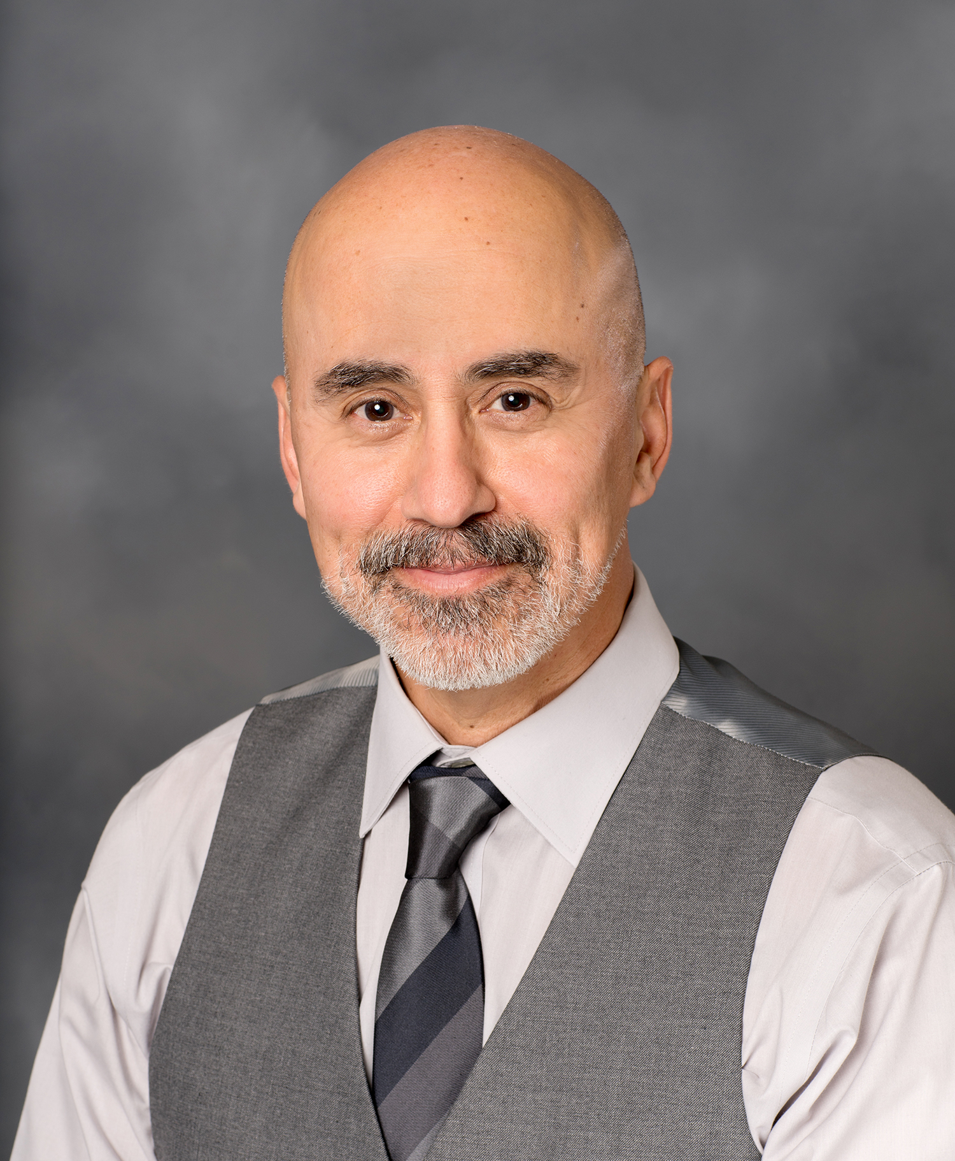
Charles Carbone, Attorney
Steve Castillo, Paralegal
P.O. Box 39755
Downey, CA 90239
www.stevecastilloconsulting.com
Copyright © 2020 Charles Carbone, Attorney at Law- All Rights Reserved.

