Slide 1
Making Sense of Rules Violations for Life Inmates Before the CA Parole Board
Charles Carbone, Esq.
Steve Castillo, Paralegal

Slide 2
Purpose
To empower families with information on rehabilitation and parole
Copyright © 2020 Charles Carbone, Attorney at Law- All Rights Reserved.
Notes:
Notes to presenter:
What is your purpose for sharing this reflection?
Is it at the end of a unit or project?
Are you sharing this reflection, at the attainment of a learning goal you set for yourself?
Is it at the end of a course?
State your purpose for the reflection or even the purpose of the learning experience or learning goal. Be clear and be specific in stating your purpose.

Slide 3
Most misunderstood fact in parole consideration
Common misconceptions: 5-year rule
Absolute bar to parole
“Rush to your denial” (i.e. go in and get it over with)
All rules violations can be explained away
Must include a nexus (“there was no drinking alcohol in my crime”)
They “already” relied on it once before.
Copyright © 2020 Charles Carbone, Attorney at Law- All Rights Reserved.

Slide 4
By Statute
15 CCR § 2281(b)
15 CCR §2281(c)(6)
15 CCR §2281(d)(9)
Circumstances tending to show SUITABIITY:
“past criminal history including involvement in other criminal misconduct which is reliably documented.”
Circumstances tending to show UNSUITABILITY: “Institutional Behavior. The prisoner has engaged in serious misconduct in prison or jail.”
And 15 CCR §2281(d)(9) “Institutional activities indicate an enhanced ability to function within the law upon release.”
Copyright © 2020 Charles Carbone, Attorney at Law- All Rights Reserved.

Slide 5
The “Bad” News:
The “Bad” News:
One or two rule violations can OVERSHADOW an abundance of self-help and rehabilitative gains. It’s the canary in the coalmine that underlying criminal thinking is unresolved and lingering.
Commissioners (Grounds, Anderson, Barton, Dobbs are harder than others such as Long, Cassady, Taira).
The “Good” News:
Rules violations are not an absolute impediment to parole. Context – “data points” matter.
Copyright © 2020 Charles Carbone, Attorney at Law- All Rights Reserved.
This Photo by Unknown Author is licensed under CC BY-SA-NC
Notes:
Notes to presenter:
Description of what you learned in your own words on one side.
Include information about the topic
Details about the topic will also be helpful here.
Tell the story of your learning experience. Just like a story there should always be a beginning, middle and an end.
On the other side, you can add a graphic that provides evidence of what you learned.
Feel free to use more than one slide to reflect upon your process. It also helps to add some video of your process.

Slide 6
What matters? What are the critical data points?
The violation
Is it violence or threat of violence against staff? | Substance abuse.
Violent “fighting” or mutual combat done inmate to inmate. | Involve high degree of lying, deceit, manipulation.
Nexus to gang activity or STG. | Impulsive/reactive v. deliberate.
How much criminal planning/deliberation is involved (drug trafficking, phone smuggling etc.) | One time or repeat.
Over-familiarity with staff. | Recent in time (immediately before or even after a parole appearance).
Involving family members, leadership role, implicating others. | Was the officer being petty?
Nexus to the life crime.
Copyright © 2020 Charles Carbone, Attorney at Law- All Rights Reserved.

Slide 7
The Five-Year Rule is only one data point. The YES and NO
YES, five years is customary.
NO, it’s not required, especially if RVR is an outlier.
YES, for violence or drugs (sometimes 3, if sobriety is profound)
NO, it’s not written in law or codified.
Yes, when part of lengthy past 115 history
NO, when inmate was immediately accepting of 115 and can present at 80 percent better than most.
Copyright © 2020 Charles Carbone, Attorney at Law- All Rights Reserved.

Slide 8
Which procedural and dynamic issues matter?
Pled guilty or not. Admit guilt at the 115 hearing or contesting and playing “legal eagle.”
Language used when s/she is caught -- “F*ck this sh*t” “My family is gonna call down here.” “You don’t know jack sh*t.”
Impulsive act v. premeditated acts.
Insight – connect the dots to habitual criminal thinking.
Acknowledge disrespect to your victims.
Possible available amends.
Past stipulations (stips) or waivers sought to give self “breathing room,” also indicating acceptance of responsibility.
Self-reported, undocumented rules violations help.
Copyright © 2020 Charles Carbone, Attorney at Law- All Rights Reserved.

Slide 9
Postponements, Waivers, and Stipulations
General Rules:
One-year waivers can give room to evaluate and strategize.
Waive or stip to less than anticipated denial period.
Waiver or stip also ensures less time spent at future hearing focused on the bad.
Waiver or stip – is appreciated by the Board, can be seen as sober thinking and acceptance of responsibility.
Stip is not saying you are unsuitable, but saying the record is insufficient right now.
Don’t commit legal suicide by “owning up to the rules violation” by going to soon.
Sometimes the “explaining” is worse than silence.
Astute lawyers make their money here doing the strategic math.
Copyright © 2020 Charles Carbone, Attorney at Law- All Rights Reserved.

Slide 10
Cell Phones
No amount of explanation will ever save you (calling grandma doesn’t matter).
Constructive possession and renting is the same as owning
How did you plead in the 115 hearing?
Legal eagle pointless battles based solely on procedure (not substance) are not helpful
It’s no “impulsive;” it’s deliberate, repeat criminal thinking
Cell phones evidence failure to accept responsibility for their life crime and demonstrate remorse

Slide 11
128’s – CAN be relied on.
Number and pattern.
Proximity to hearing date.
Smart mouth talk at play.
This officer wasn’t following prison norms.
Copyright © 2020 Charles Carbone, Attorney at Law- All Rights Reserved.

Slide 12
What the courts have to say
(+) In re Jackson, 193 CA4th 1376 (Mar. 30, 2011) 2011 WL 1142854 (POSITIVE)
REASONING: Prison misconduct not SE of CD. "disciplined several times for non-violent infractions of prison rules, but not disciplined since 1992." - at *5
Note: Court does not say whether these were 115 or 128.
2. (+) In re Gomez, 190 Cal. App. 4th 1291 (Dec. 15, 2010) (POSITIVE)
REASONING:
Def had one non-violent 115 in 2003 for excessive conduct in visiting room - at 1299
Not much discipline discussion, but no evidence in record (which includes the 115) supported Gov's decision - at 1306.
Copyright © 2020 Charles Carbone, Attorney at Law- All Rights Reserved.
This Photo by Unknown Author is licensed under CC BY-SA-NC

Slide 13
What the courts have to say – cont.
3. (-) In re Hare, 189 CA4th 1278 (Oct. 18, 2010) (NEGATIVE)
REASONING
Court held def's denial of intent to create a weapon from toothbrush showed tendency to hide the truth. Def's present tendency to hide truth was nexus to commitment offense because he lived under false name for 3 years to evade punishment.
4. (-) In re Reed, 171 Cal.App.4th 1071 (Mar. 5, 2009) (NEGATIVE)
REASONING
128A is evidence of dangerousness
Discipline violated specific directive from parole board only 2 months prior and was evidence of unsuitability because it showed he would not comply w/ reasonable parole conditions. - at 1083-84
Not stale b/c occurred within a year of the hearing - at 1085.
it was not an isolated incident; instead, it was part of an extensive history of institutional misconduct, including 11 CDC 115's and 19 CDC 128–A's. - at 1085
Copyright © 2020 Charles Carbone, Attorney at Law- All Rights Reserved.
This Photo by Unknown Author is licensed under CC BY-SA-NC

Slide 14
What the courts have to say – cont.
5. (+) In re Palermo, 171 Cal. App. 4th 1096 (Feb 11, 2009) (abrogated by Prather) (POSITIVE)
REASONING
Disciplinary history
His three disciplinary reports not evidence of dangerousness because only 3 in 20 years, all non-violent. - at 1110
6. (+) In re Aguilar, 168 Cal. App. 1479 (Dec. 11, 2008) (POSITIVE)
Prison discipline was for "Disrespect without potential for Violence" and "Disobeying a Direct Order" - at 1484.
REASONING:
Two non-violent prison rule violations
Court does not say if 115 or 128A
But both involved no violence so not sufficiently serious to deny parole – 1491
Copyright © 2020 Charles Carbone, Attorney at Law- All Rights Reserved.
This Photo by Unknown Author is licensed under CC BY-SA-NC

Slide 15
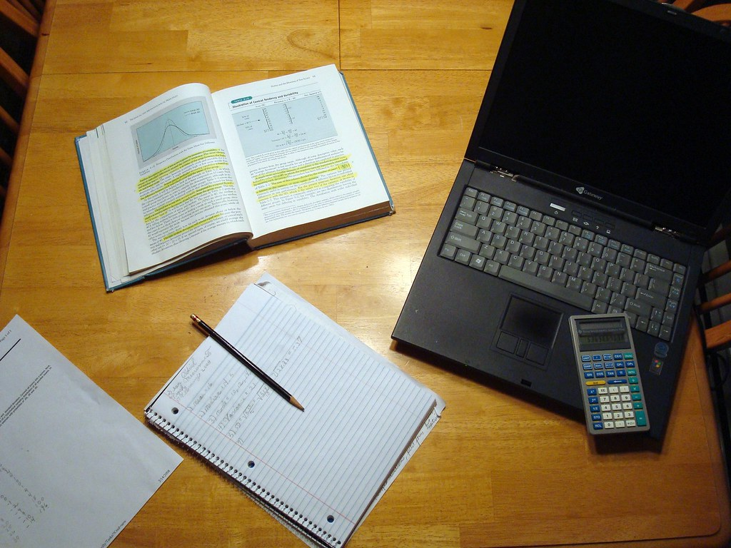
HOMEWORK
1. Stop getting them
6. Seek amends
7. Strategized with an attorney regarding data points and import to waiver, stipulation or proceed
2. Inventory history
3. Identify criminal thinking/excuses/justifications-connect the dots
4. Inventory harm
5. Tailor self-help to address underlying causative factors
Copyright © 2020 Charles Carbone, Attorney at Law- All Rights Reserved.
This Photo by Unknown Author is licensed under CC BY-ND

Slide 16
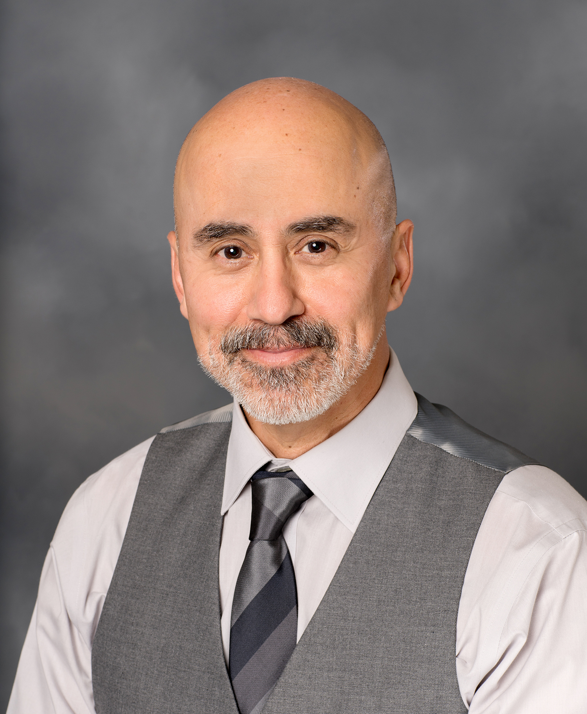
Charles Carbone, Attorney
Steve Castillo, Paralegal
P.O. Box 39755
Downey, CA 90239
www.stevecastilloconsulting.com
Copyright © 2020 Charles Carbone, Attorney at Law- All Rights Reserved.

