Slide 1
How to Write a Letter of Remorse and Victim Impact Statement
Charles Carbone, Esq.
Steve Castillo, Paralegal

Slide 2
Why Write a Letter of Remorse and Victim Impact Statement?
Copyright © 2020 Charles Carbone, Attorney at Law- All Rights Reserved.
Notes:
Notes to presenter:
What is your purpose for sharing this reflection?
Is it at the end of a unit or project?
Are you sharing this reflection, at the attainment of a learning goal you set for yourself?
Is it at the end of a course?
State your purpose for the reflection or even the purpose of the learning experience or learning goal. Be clear and be specific in stating your purpose.

Slide 3
First Reason: Governing Regulations: 15 CCR 2281(d)(3)
OPERATIVE LANGUAGE OF THE LAW
Emphasis on Acts
Repairing damage
Seeking help/relieving suffering: no more victims and make amends
Understands nature and magnitude of the offense
“Signs of Remorse. The prisoner performed acts which tend to indicate the presence of remorse, such as attempting to repair the damage, seeking help for or relieving suffering of the victim, or the prisoner has given indications that he/[she] understands the nature and magnitude of the offense.”
Copyright © 2020 Charles Carbone, Attorney at Law- All Rights Reserved.
Notes:
Notes to presenter:
Description of what you learned in your own words on one side.
Include information about the topic
Details about the topic will also be helpful here.
Tell the story of your learning experience. Just like a story there should always be a beginning, middle and an end.
On the other side, you can add a graphic that provides evidence of what you learned.
Feel free to use more than one slide to reflect upon your process. It also helps to add some video of your process.

Slide 4
Second Reason: Demonstrates Rehabilitation
Essential to overall rehabilitative path-rigorous honesty; sobriety
Criminals love secrets and lying by omission: Have you had “the talk” – about the real, detailed facts of the life crime?
Acts as a deterrent and motivator against offenses
End of dehumanizing/blaming of victim and of life circumstances for the crime
Steps 5, 8-9
Copyright © 2020 Charles Carbone, Attorney at Law- All Rights Reserved.
Notes:
Notes to presenter:
Description of what you learned in your own words on one side.
Include information about the topic
Details about the topic will also be helpful here.
Tell the story of your learning experience. Just like a story there should always be a beginning, middle and an end.
On the other side, you can add a graphic that provides evidence of what you learned.
Feel free to use more than one slide to reflect upon your process. It also helps to add some video of your process.

Slide 5
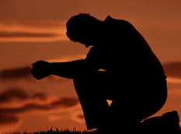
Core Definition of Remorse
A gnawing distress arising from a sense of guilt for past wrongs
Deep regret or guilt for a wrong committed
Shame, guilt, regret sorrow, sadness
Regret for WHOM?
NOTE: DA’s will often argue that the lifer has “regret” that the crime happened to them, but not the victim
Accepted Definition:
Empathy – your shoes in the other – Demands you know name, age, gang status, profession, parental status, family status, interests, passions, personality, interests of the victim
NOTE: Did you pay attention to victim statements at sentencing, contents of probation officer’s report, and or what was said by VNOKs/victims at the last parole hearing?
Copyright © 2020 Charles Carbone, Attorney at Law- All Rights Reserved.

Slide 6
Amends
Direct amends - to your victim
Indirect amends – to as close as possible
Living amends – change the way you live
Copyright © 2020 Charles Carbone, Attorney at Law- All Rights Reserved.

Slide 7
Part 1: The Letter

Slide 8
John Lifer
#D-00000 / D5-213L
CSP-MCSP
P.O. Box 409020
Ione, CA 95640
October 12, 2020
Dear Victim #2,
My name is John Lifer, and I am the person responsible for the murder of your brother Victim #1 on January 16, 1987, at Mr. G’s Bar in Bakersfield, California. I may not have pulled the trigger of the gun used to murder your brother, but I am responsible, nevertheless.
As you know by your presence at the bar that night, I am responsible because I put the deadly chain of events into motion by picking a fight with your brother, and then instigating my co-defendant Mike Lifer to the point -- where he shot your brother. Making matters worse, I am responsible for my act of cowardice by fleeing the scene with my co-defendant to avoid capture by the police. I also refused to take responsibility and be accountable for my crimes at the trial, and during many years of my incarceration. Instead, I blamed my co-defendant and claimed to be a victim of the justice system.
Mr. Victim #2, for these reasons and more, I am writing to apologize for the destruction I brought upon your family by way of psychological and emotional trauma, and, financial hardship. And I apologize for taking so long to do so.
About 12 years ago, I had a near death experience following a prison riot wherein I was almost killed. It may sound irrational, but that experience in many ways was a blessing to me. It was if all my selfish ways of living came to a screeching halt. After that experience, I began to examine the totality of my life. I thought: “if I had died what would have been my legacy?” And sadly, the conclusion was that I was one of the most selfish individuals on the face of the earth; living with no boundaries as a gang member, drug addict, and criminal. Worse still, I am responsible for the death of another human being, your brother, Victim #1. With each passing day the magnitude of what I did to your family began to bear on my mind. It was then that I decided to renounce all ways of destructive living, by seeking help in rehabilitative programs.

Slide 9
One program that helped me face the reality of what I did to your family was Victim Awareness. In that program, we got to meet and hear stories of real crime victims. And we were encouraged to journal out our own crime from the perspective of our victims. To be honest, it was a very difficult journey. But I felt that I owed that to Victim #1, you, and your family.
Based on the evidence and testimony in my case, I can imagine the following:
The last look your brother had alive was seeing the shock of horror upon your face. The last look you had of your brother was his look of bewilderment at your reaction. But what haunts me, even to this day, was your brother’s blood and brain matter that struck you in the face; and the helplessness you felt to save your brother’s life.
I do not expect you to believe me, but it sickens me when I think about what your family suffered; and that I am the cause of that eternal suffering. I realize at some point you had to call your parents that night and tell them of the tragic news; not only that your brother was murdered, but the manner in which he was. You had to hear the deafening screams of your parents; you had to find the money to bury your brother; you had to find the strength to attend his funeral and bury him; you had to encounter sleepless nights and nightmares over what I did; you and your family will never hear his voice or laughter; you will never get to feel his embrace or see his smile. Mr. Victim #2, I am so sorry for what I did. And I know it sounds so cliché to say that I wish I could undo what I did, but that is the depth of remorse I feel at the core of my being.
Mr. Victim #2, about the only consolation I can offer you is that I am no longer that evil and despicable person that murdered your brother. In fact, by participating in programs and therapy, I have learned to use the profound shame, regret, and guilt I feel to motivate me to be a better human being. And with your permission, I would like to begin donating funds to an account in memory of your brother Mr. Victim #1; with such funds being used by your family or charity of your choosing. Please let me know if this something you would be open to. And should you have any questions or wish to write me and express whatever you want to me, I am open to receive you. You can contact me at the address above.
Once again, I am profoundly sorry for my actions against your family.
Sincerely,
John Lifer, #D-00000

Slide 10
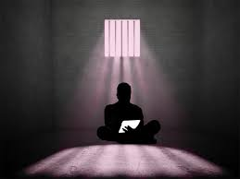
Key Components of a “Letter”
Reason you are writing. And why now
(if late, why now, why did you wait, was there a precipitating event?
2. State your apology
I am sorry for WHAT?
What are you regretful/remorseful for?
BE SPECIFIC
Don’t tell me the color of your socks but leave out details of the rape.
Copyright © 2020 Charles Carbone, Attorney at Law- All Rights Reserved.

Slide 11
Key Components of a "Letter”- cont.
3. What are you responsible for?
Background identity; person you had become; lifestyle you were living; prior treatment/abuse.
Affirmative acts in the crime
Acts of omission – could, should, would
Actual details of the crime; after reading from neutral audience should know what you did and were convicted of.
4. Point out victim did no wrong; undeserving; genuine innocent victim.
Copyright © 2020 Charles Carbone, Attorney at Law- All Rights Reserved.

Slide 12
Key Components of a “Letter”- cont.
5. Accept and Acknowledge Impact
Personal injuries
Manner of death – pain and suffering and fear in passing
Loss of property
Persistent physical pain and suffering
Destroyed branch/trunk in family tree
Expenses, lost work
Fractured relationships
Mental anguish, harm, trauma, PTSD
Physical and emotional/mental scars
Insult to injuries (denials at trial, the trial itself, parole hearings, previous denials)
Copyright © 2020 Charles Carbone, Attorney at Law- All Rights Reserved.

Slide 13
Key Components of a “Letter”- cont.
6. Statement of Future Intentions
Don’t gloat/over promote successes or rehabilitation.
It’s not an “I’ve been so awesome in prison” letter.
It’s not about your life (past, present, or future), it’s about their loss.
Discuss how your living amends.
Desire to make direct and indirect amends (yet don’t belittle their loss).
Don’t say you accept full responsibility if you are still committing rules violations in prison.
7. The “Ask”
Don’t ask for forgiveness
Give your apology; terribly sorry, deeply remorseful, deepest/biggest regret of your life
Copyright © 2020 Charles Carbone, Attorney at Law- All Rights Reserved.

Slide 14
General Principles
When: as early as possible without being vapid
To Whom? Co-centric circles
- Victim #1 (person directly harmed)
- Victim #2 (family of victim)
- Victim #3 (friends)
- Victim #4 (citizens/people of the country is a good inclusion for prosecutors, court, police, coroner, etc.
Good foundation: re-telling the crime through the victim’s eyes.
Do not litigate outcome-not a letter to the jury.
Admit you might not be the best historian
Evolving versions (no more than 3) if you genuinely have something to say.
Avoid “passive voice”—not “my anger caused me,” “I caused the death of..,” “Influenced by bad associations,” “got the best of me.” Crime didn’t happen to you; you created and caused the crime.
Delivered to the correctional counselor or attorney (preferably after its been reviewed by attorney for submission to the Board).
Copyright © 2020 Charles Carbone, Attorney at Law- All Rights Reserved.

Slide 15
General Principles – cont.
Never directly write the DA
Watch out for generalizations (“I made terrible decisions.”)
Realize that VNOK may still not be received well.
Remorse is more actions, than crying
Be respectful of religious diversity; tone down the religiosity.
Don’t blame victim or others for crime
Copyright © 2020 Charles Carbone, Attorney at Law- All Rights Reserved.

Slide 16
Part 2: Victim Impact Statement

Slide 17
John Lifer
#D-00000 / D5-213L
CSP-MCSP
P.O. Box 409020
Ione, CA 95640
October 12, 2020
Board of Parole Hearings (BPH)
P.O. Box 4036
Sacramento, CA 95812
Re: Life Crime Impact Statement
Dear Honorable Commissioners:
My name is John Lifer #D-00000 and I am an inmate within the California Department of Corrections and Rehabilitation (CDCR). I submit this Life Crime Impact Statement for consideration at my parole hearing scheduled for December 3, 2020.
I am responsible for setting off a chain of deadly events on January 16, 1987, at Mr. G’s Bar in Bakersfield, California. The events resulted in the shooting death of Victim #1 (27 yrs.), and the terrorization of all witnesses present at the scene of my crime, including the brother of Victim #1,
Victim #2 (24 yrs.)
While sitting at a table talking with his brother inside the bar, with his back to a nearby door, Victim #1 was shot in the back of the head five times -- at point blank range. The shooter was my co-defendant, Mike Lifer. I aided Mike Lifer in his escape from the scene of my crime by driving him away in my car. Victim #2 suffered psychological and emotional trauma as he witnessed Mike Lifer point the gun to the back of his brother’s head, and fire; with blood and brain matter striking him in the face. Victim witnesses also suffered psychological and emotional trauma as they saw Victim #1 dying from his deadly wounds. Other people I have identified as victims is the family of Victim #1; first responders, police; coroners; the surrounding community; prosecutors; and even the taxpayers of California.

Slide 18
All of these events tragically transpired because I grew angry over Victim #1 refusing to front me drugs. After Victim #1 refused to front me drugs, I challenged him to a fight. When Victim #1 declined to fight me, I made the decision to rob him. I informed Mike Lifer of Victim #1 refusal to front me drugs, and my intentions to rob Victim #1. Mike Lifer then walked out the back door of the bar -- around to the front door -- opened the door -- and shot Victim #1, killing him.
I struggle to find the words that can adequately describe the profound shame, regret, and sorrow I feel for my crimes. My crime was senseless. Making matters worse, instead of facing the consequences for my crime, I fled from the scene. Instead of taking responsibility of my crime, I blamed my co-defendant. Instead of making myself accountable for my actions, I litigated my case in the court all the while claiming to be a victim of the justice system.
As a result of my crimes, family and friends will never hear the voice, laughter, or cries of Victim #1; they will never see his smile; and they will never feel his embrace. Victim #1 was only 27 yrs. old. He had a whole life yet to live. He could have been a father, grandfather, or great-grandfather. I had no right to deprive him of his right to life. I am sickened at the thought that the last thing Victim #1 saw was the look of horror upon his brother’s Victim #2 face. I am also sickened at the thought that the last look Victim #2 had of his brother alive, was a split-second look of bewilderment upon his brother’s face -- just before the bullets struck him dead. I thought long and hard about what if I was Victim #1 and Victim #2: I would not want to be murdered like that. And neither would I want my brother’s brain matter and blood all over my face. Victim #2 was likely distraught and depressed for many years, maybe even requiring medical or mental health attention for trauma. I can only imagine how difficult it must have been for him to call home to his parents and inform them that not only was their son murdered, but the manner in which he was. The shock and pain of the news likely caused his parents to experience many sleepless nights, with unrelenting tears.
Others who likely experienced sleepless nights were the victims who witnessed the shooting of saw Victim #1 and seeing the life drain from his body. These victims went to the bar for a relaxing evening, maybe after a hard day's work, never expecting to see another human being murdered right before their eyes. As result of my crime, these victims may never set foot in a bar ever again. Even for first responders, police, coroners and prosecutors who had to deal with yet another wreckage of young life. No one wants to see another human being dead, especially with their brains blown out.
I think about the surrounding community who heard screaming sirens and saw flashing lights by police and ambulances, wondering what had happened; and wondering if they were in danger themselves. Fear may have propelled them to run to their homes, lock their doors, and maybe even arm themselves in self-defense. And speaking of community, I think about the millions of dollars spent on my incarceration; all of which could have been better spent on education, public safety, and social programs.

Slide 19
In 2005, I had a near death experience following a prison riot in which I was stabbed several times. This was the pivotal point for me in my incarceration as I began to think how close I came to dying. Then I began to think about Victim #1. Thinking more and more about my life, wasted years inside institutions, and the destruction I caused in so many lives. I finally decided to stop the madness and seek help. I sought help in prison programs where we explore our lives, crimes, victims, addictions, criminality, and character defects. Talking more and more about my crimes and victims has helped to deflate my ego and self-centeredness, increase my empathy for others, and make me more determined to be a better person.
In closing, I have finally discovered that the best way I can express my remorse is not only by taking responsibility for my crimes, but by living differently. My record will reflect that I have 12 years disciplinary free with no association to gangs, criminals, substances, or violence.
I am thankful to God, family, friends, staff, and the many prison programs that have helped shaped me into the man I am today. And I am thankful for the careful consideration you give to this statement.
Respectfully Submitted,
John Lifer, #D-00000
Attachments: Letter of Apology to Victim #2

Slide 20
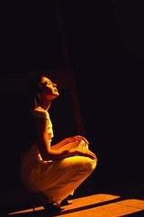
Key Components of a Statement
WHO - did you harm – Name and Ages – More in common, than not.
HOW - were they injured – from largest to smallest
WHY - less emphasis
REVIEW – trial transcripts, Probation Officer’s Report, Sentencing Transcript, Police Reports, and Autopsy Reports
Copyright © 2020 Charles Carbone, Attorney at Law- All Rights Reserved.

Slide 21
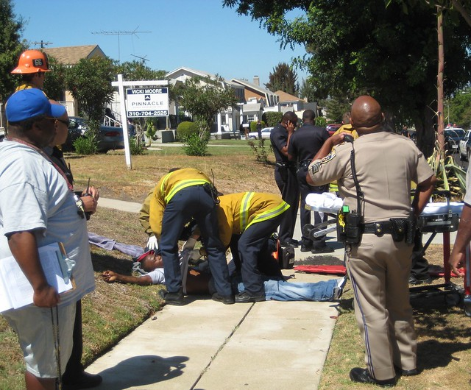
Special Considerations on Impact
Gangs – perpetual war, innocent bystanders.
Sex crimes – invisible scars, calcified wounds, shame, can’t talk about it.
Domestic violence – violence in the home, ruptured families.
Children – uniquely vulnerable and larger loss of life.
Elderly – uniquely vulnerable
Copyright © 2020 Charles Carbone, Attorney at Law- All Rights Reserved.

Slide 22
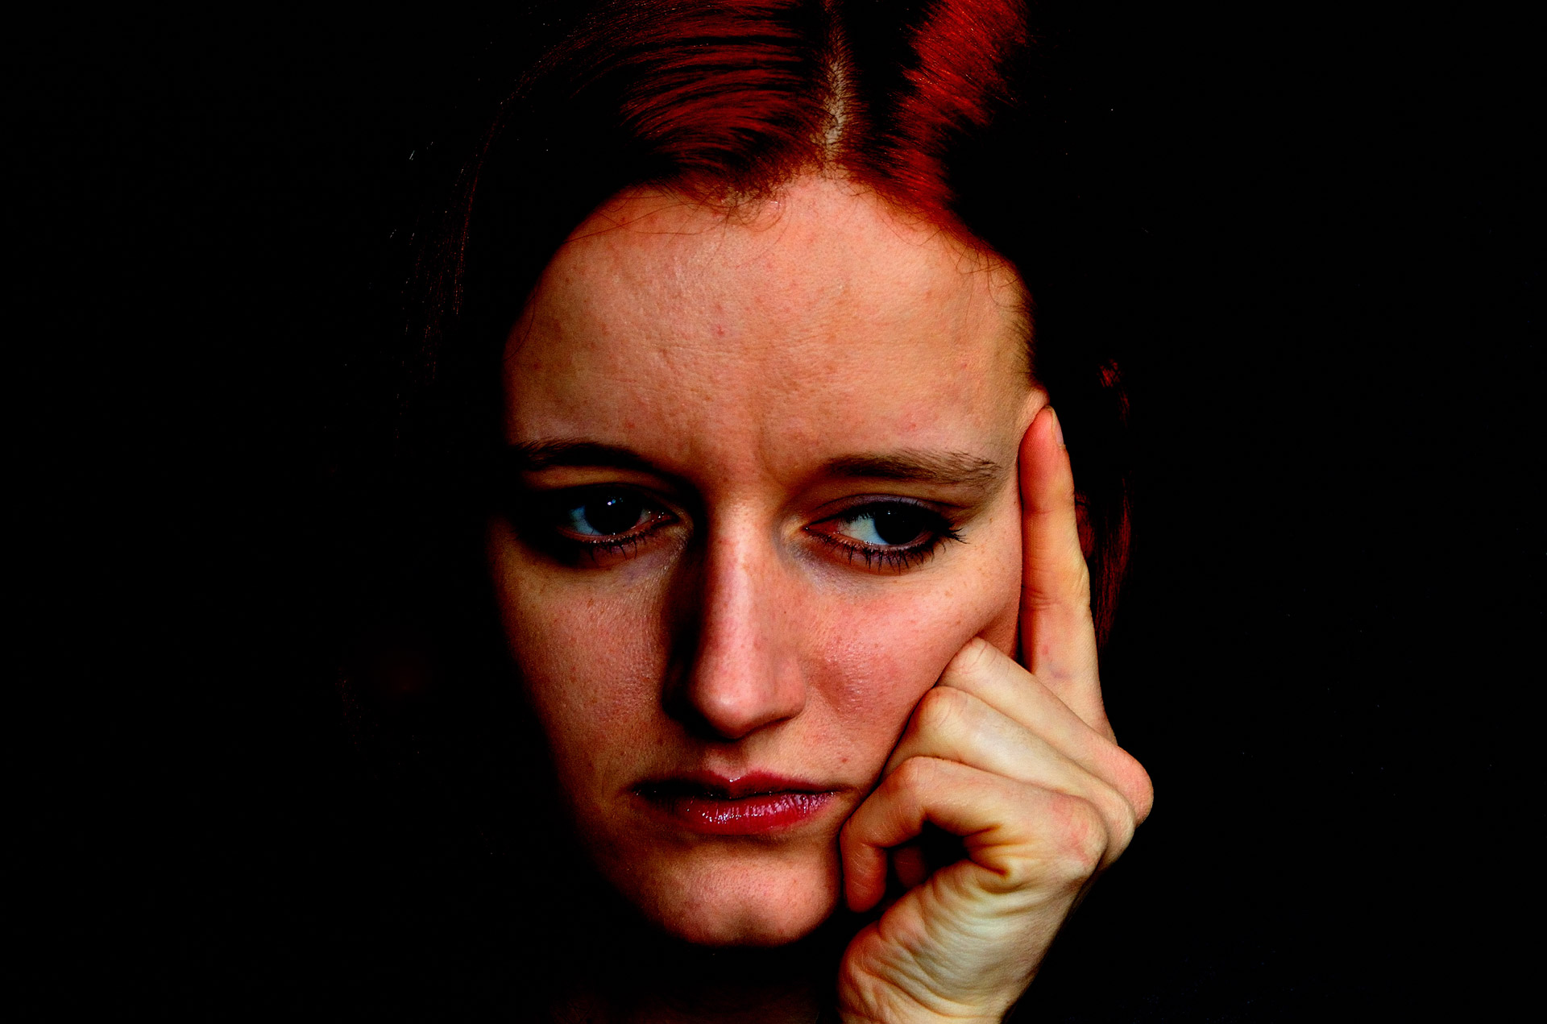
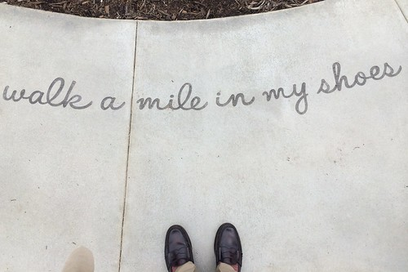
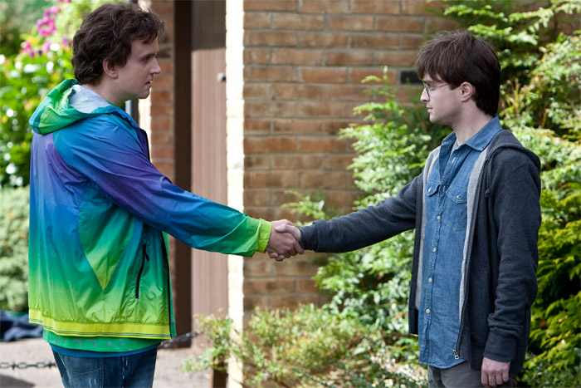
What are your next steps?
Think about your crime
4
Put yourself in their shoes
3
2
Start writing
1
Make amends
Copyright © 2020 Charles Carbone, Attorney at Law- All Rights Reserved.
Notes:
Notes to presenter:
What steps will you be taking as a result of this learning experience?
Did you learn from any failed experiences? How will you do things differently?
What advice will you give to others so they can learn from your experiences?
How can you share what you learned with a real-world audience?
Some examples of next steps might be:
After delivering my first persuasive presentation, I am thinking about joining the debate team.
After making my first film, I’m considering entering it in our school film festival or local film festival.
After connecting with this career expert, I’d like to do some research on that career field because it sounds interesting to me.
This SmartArt allows you add images and text to help outline your process. If a picture is worth a thousand words, then pictures and words should help you communicate this reflection on learning perfectly! You can always click on Insert>SmartArt to change this graphic or select the graphic and click on the Design contextual menu to change the colors.
Feel free to use more than one slide to share your next steps. It also helps to add some video content to explain your message.

Slide 23
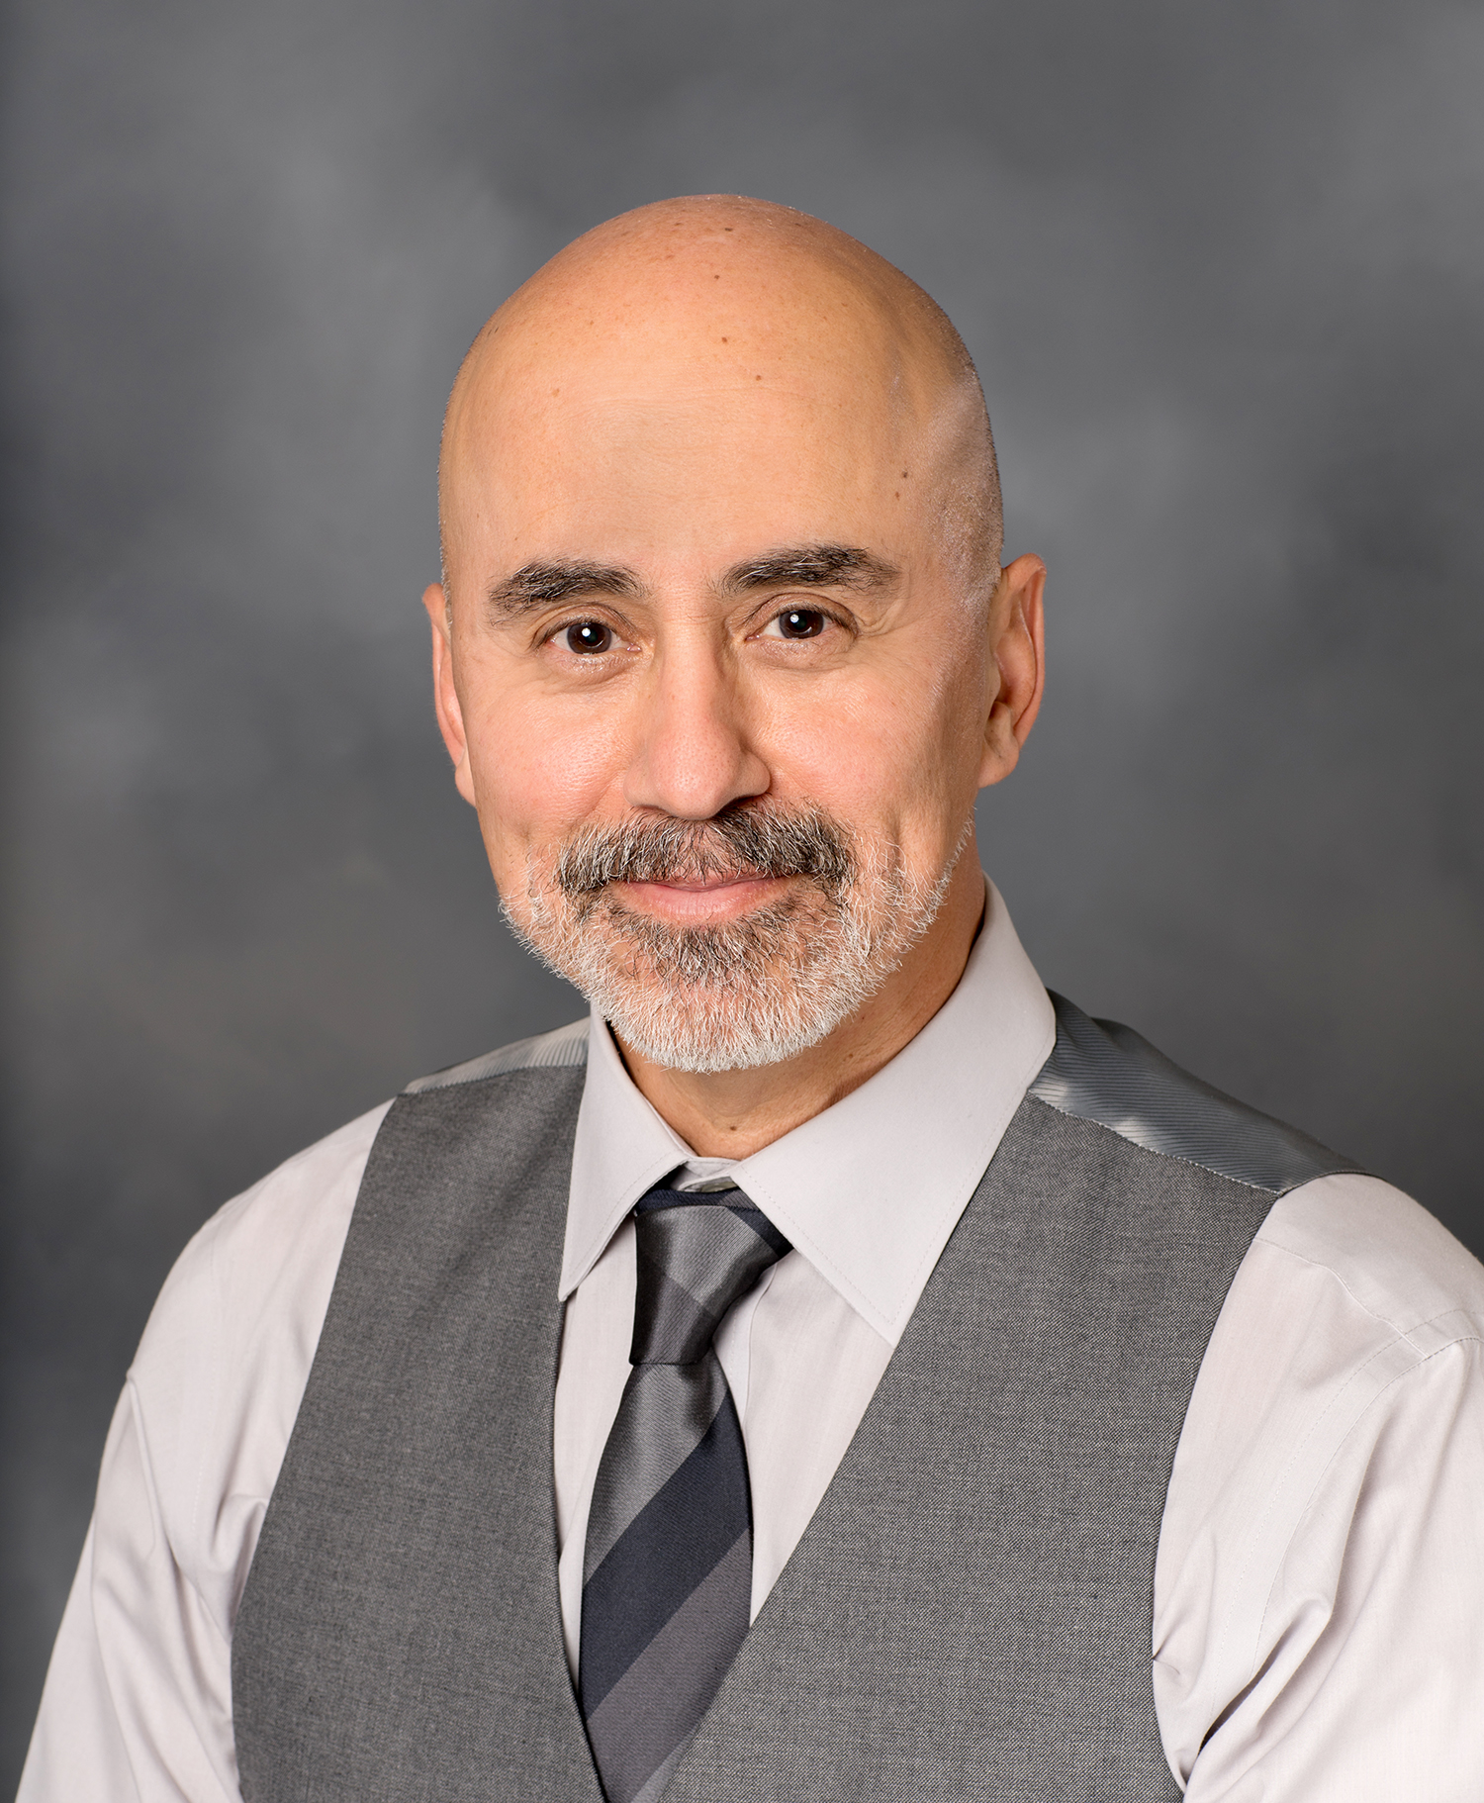
Charles Carbone, Attorney
Steve Castillo, Paralegal
P.O. Box 39755
Downey, CA 90239
www.stevecastilloconsulting.com
Copyright © 2020 Charles Carbone, Attorney at Law- All Rights Reserved.

